Slide 1
Surveying the Cyberspace
Cybersecurity 101 Day 3

Slide 2

Class Objectives
By the end of today’s class, you will be able to:
Articulate roles and career pathways within the cybersecurity space.
Explain the landscape of certifications available to security professionals.
Articulate what the Security+ exam is and which infosec pathways benefit from the certification.

Slide 3




Quick Review
Last class, we offered advice on a vulnerable login.
Login
Web Login
Server
Data
Which elements of this diagram did we conclude were potential targets?
Users and Admins

Slide 4
Quick Review
All of them!
Login
Web Login
Server
Data
In every case, an attacker could target every node along the chain.
Users and Admins

Slide 5
Quick Review
Name three user attacks.
Users and Admins

Slide 6
Quick Review
Name three user attacks.
Social engineering
Credential reuse
Malware attacks
Man in the middle
Packet sniffing
Users and Admins
Computer theft

Slide 7
Quick Review
Name one website attack.
Login
Web Login

Slide 8
Quick Review
Name one website attack.
Login
Brute force attacks
Code injection
Session stealing
Web Login

Slide 9
Quick Review
Name one server attack.
Server

Slide 10
Quick Review
Name one server attack.
OS exploits
Code injection
Server

Slide 11
Quick Review
Name one database attack.
Data

Slide 12
Quick Review
Name one database attack.
Default credentials
Unpatched database
Lack of segregation
Data

Slide 13
Quick Review
User Attacks
Web Attacks
Database Attacks
Social engineering
Brute force attacks
Default credentials
Phishing attacks
Code injection
Unpatched database
Credential reuse
Faulty sessions
Lack of segregation
Malware attacks
Man in the middle
Server Attacks
Name three
risk mitigation options.
Packet sniffing
OS exploit
Computer theft
Malicious software

Slide 14
Quick Review
Name three risk mitigation options.
1. Educate all users on dangers of phishing and social engineering.
2. Ensure passwords are truly unique to website (require characters atypical of other websites).
3. Ensure users are using multi-factor authentication (login + phone confirmation).
4. Ensure administrators can only access the network from a secure location (on premises).
5. Ensure passwords used are strong (alphanumeric + symbols).
6. Ensure login fields do not accept any code insertions.
7. Ensure users are immediately signed off when browser is closed.
8. Ensure all servers are routinely patched against latest known vulnerabilities.
9. Ensure physical access to servers is protected by multiple forms of authentication.
10. Ensure that all data stored in the database is encrypted and cannot be read without additional login information.
11. Ensure that all cloud security platforms follow best practices for security implementation.

Slide 15
Cybersecurity Domains

Slide 16
Providing advice on getting started in digital security is similar to providing advice on getting started in medicine.
If you ask a neurosurgeon, he or she may propose some sort of experiment with dead frog legs and batteries. If you ask a dermatologist, you might get advice on protection from the sun whenever you go outside. Asking a “security person” will likewise result in many different responses, depending on the individual’s background and tastes.
’
’
’
’
—Tao Security’s Richard Bejtlich on entering the cybersecurity field

Slide 17
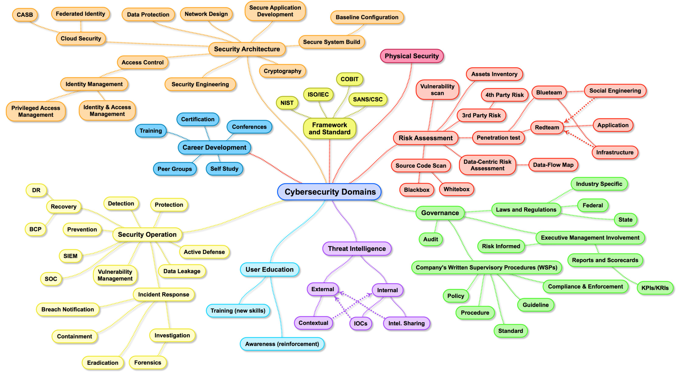
Cybersecurity Domains
Map of Cybersecurity Domains v2.0 by Henry Jiang
Notes:
https://www.linkedin.com/pulse/map-cybersecurity-domains-version-20-henry-jiang-ciso-cissp/

Slide 18
Cybersecurity Domains
Security architecture: Security design that addresses the requirements and potential risks of a given scenario or environment. It also specifies when and where to apply security controls.
Security operations: Process of identifying, containing, and remediating threats on behalf of a company or organization.
Governance: Framework for managing performance and risk, oversight of compliance and control responsibilities, and defining the cyber mission by mapping the structure, authority, and processes to create an effective program.

Slide 19
Cybersecurity Domains
Physical security: Protection of personnel, hardware, software, networks, and data from physical actions and events that could cause serious loss or damage. Includes protection from fire, flood, natural disasters, burglary, theft, vandalism, and terrorism.
Threat intelligence: Research and analyzation of evidence-based knowledge regarding an existing or emerging menace.
Career development: Training of future cybersecurity professionals.

Slide 20
Cybersecurity Domains
Risk assessment: Analyzing what can go wrong, how likely it is to happen, what the potential consequences are, and how tolerable the identified risk is.
User education: Teaching users how to protect themselves from cyberattacks by informing them of risks, exploits, and external threats, and the skills needed to combat common attacks.
Frameworks and standards: Creation of new security frameworks and practices for professionals to follow.

Slide 21
Activity: Career and Pathway Research
In this activity, we will begin to research security careers and pathways in depth.
10 Minutes

Slide 22
Share your answers.

Slide 23
Sample (Entry Level) Cybersecurity Titles
Knowing the correct job titles and job types is the first step in pursuing a career in the space. Be precise in your search!
Security Analyst | Security Operations Center (SOC) Analyst | Security Engineer | Systems Engineer
Cyber Threat Analyst | Cyber Defense Analyst | Incident Response Analyst | Intelligence Analyst
Information Assurance Technician | Risk Analyst | Forensics Investigator | Systems Administrator
Network Engineer | IT Auditor | Application Security Engineer | Penetration Tester
Information Analyst | Systems Security Analyst | IT Specialist | Web Engineer - Application Security

Slide 24
Cyber Fields by the Numbers
According to a report from Frost and Sullivan and (ISC)², there will be more than 1.5 million unfilled cybersecurity positions by 2020.
From ISACA:
53% of organizations take up to 6 months to find qualified cybersecurity candidates.
Cybersecurity jobs grew three times faster than IT jobs between 2010 and 2014.
84% of organizations believe half or fewer of its applicants for open security jobs are qualified.
From (ISC)²:
A full 87% of all cybersecurity professionals started their careers doing something different.

Slide 25
Career Context (Common Pathways)
0 Years
1-2 Years
2-4 Years
4-6 Years
6-10 Years
1
Tech Enthusiasts
Help Desk /
IT Support
Network / System Admin
Information Security Analyst
System Security Administrator
IT Security Engineer
Penetration Testing Lead
Digital Forensics Manager
Cybersecurity Manager
Application Security Consultant
2
MIS / CS
Degree
Information Analyst / Developer
3
Business
Consultants
Risk Analyst

Slide 26

Career Services Department
In class, we will tie concepts and skills in our program to career outcomes and roles. Outside of the classroom, the Career Services team will do the practical, hard work, helping you get a new role or promotion.
There are several career milestones for you to complete in Bootcamp Spot.
You have access to them all now and can submit milestones whenever you want.
However, you will need to submit at least one milestone in order to unlock Career Services.
One of the milestones, an updated, polished resume, will be a requirement in one of our later homework assignments, but you can submit this earlier if you want.
Review the slides on Becoming Employer Competitive, Working with Your Profile Coach, and Working with Your Career Director.
Notes:
Image source: ARCADE

Slide 27
Security Certifications

Slide 28

Security Certifications
As the demand for cybersecurity careers grows, employers frequently look to certification as a measure of employee qualifications and training when hiring.
CompTIA certifies Security+ and PenTest+.
EC Council certifies CEH and ECIH.
(ISC)² certifies CISSP and SSCP.
Offensive Security certifies OSCP and OSWP.
GIAC certifies GPEN and GCIH.
Today, we’ll take a closer look at CompTIA’s Security+ certification and exam.

Slide 29
3-5 minutes
Activity: Certification Landscape
Let’s take a quick look at this list of over 100 professional security certifications.
Go to:
en.wikipedia.org/wiki/List_of_computer_security_certifications

Slide 30

Of the 100+ certifications, today we’ll focus on one of the most in-demand:
Security+
30
Notes:
Image source: Studio Bolland

Slide 31
What is a Security+?
According to CompTIA, Security+:
Is the first security certification that IT professionals should earn.
Establishes core knowledge required for any cybersecurity role.
Provides a springboard to intermediate-level cyber jobs.
Incorporates hands-on troubleshooting to ensure practical security problem-solving.
CompTIA (Computing Technology Industry Association) is a non-profit trade organization that certifies qualified applicants in various information technology skills.
Provides testing and certification for Security+, Network+, CASP+, and PenTest+.

Slide 32
Introduction to Security+ Certification
What are some jobs that may require the Security+ certification?
Security
consultant
Security
architect
Information security
analyst
Security
engineer
Security
specialist
Security /
systems
administrator

Slide 33

As of September 2020, the average annual pay for an information security analyst in the United States was $99,944.
Stat Reference: https://www.ziprecruiter.com/Salaries/Information-Security-Analyst-Salary
Notes:
Image source: shutterstock_294234533

Slide 34

At Which Point in Your Career Should You Take The Exam?
Security+ is considered an entry-level exam. The skills we’ll learn in this course will offer strong foundations for many topics covered on the exam.
However, the Sec+ exam is broad and will require additional knowledge in areas that aren’t covered in this program.
The CompTIA CertMaster tool will provide the material needed to close these gaps and master the exam.
Notes:
Image source: shutterstock_1560319826

Slide 35


Why Don’t We Cover Everything on the Sec+ Exam?
This course focuses on providing relevant hands-on experience of the most common and useful concepts, tools, and technologies used in security and networking. It is not a test prep course.
Some topics on the Security+ exam are not covered in this course because they are highly specific, and relevant only to certain subfields of cybersecurity.
While this course and exam share many overlapping topics, more niche topics covered on the exam will require additional study.
For example, the TACACS+ protocol appears on the Security+ exam, but it is only used by engineers who work specifically with Cisco devices.
Notes:
Image source: Jeevanantham_Jiva

Slide 36

Security+ Specs
You get the Security+ certification by passing the CompTIA-administered Security+ exam.
There are 90 multiple-choice and performance based questions.
The exam lasts 90 minutes.
The cost of the exam is $339.
The exam is vendor-neutral.
Notes:
Image source: shutterstock_1276756537

Slide 37
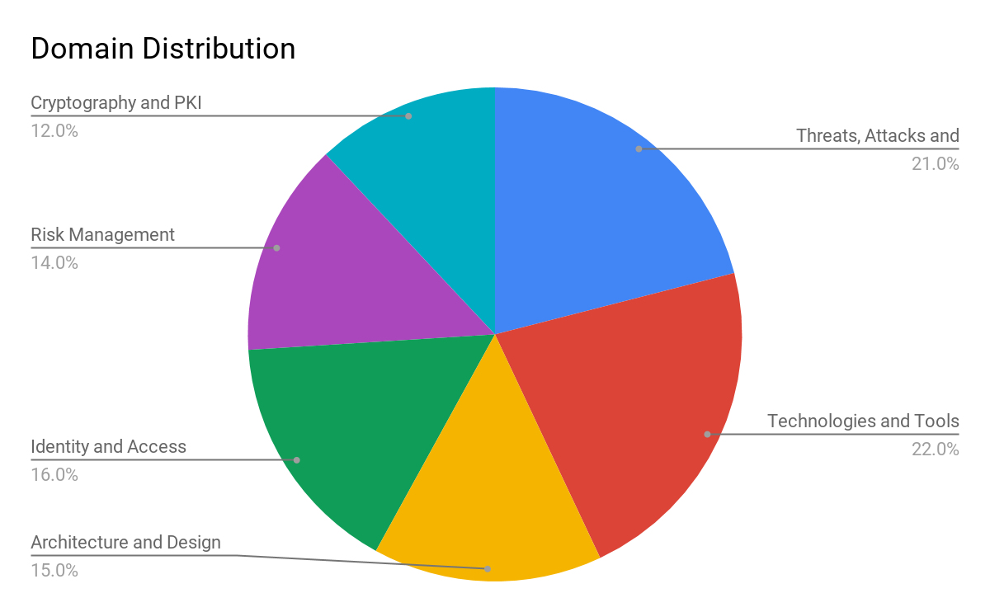
Security+ Exam Topics Breakdown
Threats, Attacks, and Vulnerabilities
Technologies and Tools
Architecture and Design
Identity and Access Management
Risk Management
Cryptography and PKI
Threats, Attacks, and Vulnerabilities

Slide 38
Question Formatting

Slide 39
There are two types of questions on the Security+ exam: multiple choice and performance based.

Slide 40

Example Question: Multiple Choice
Which of the following describes a logic bomb?
A program that performs a malicious activity at a specific time or after triggering an event.
A type of malicious code similar to a virus whose primary purpose is to duplicate itself and spread, while not necessarily internally damaging or destroying resources.
A program that appears to be a legitimate application, utility, game, or screen saver that performs malicious activities surreptitiously.
A program that has no useful purpose, but attempts to spread itself to other systems and often damages resources on the system where it is found.
Notes:
Image source: shutterstock_1028887237

Slide 41
Example Question: Multiple Choice
Which of the following describes a logic bomb?
A program that performs a malicious activity at a specific time or after triggering an event.
A type of malicious code similar to a virus whose primary purpose is to duplicate itself and spread, while not necessarily internally damaging or destroying resources.
A program that appears to be a legitimate application, utility, game, or screen saver that performs malicious activities surreptitiously.
A program that has no useful purpose, but attempts to spread itself to other systems and often damages resources on the system where it is found.
Notes:
Image source: shutterstock_1028887237

Slide 42

Example Question: Performance Based
Scenario: You are responsible for security at a small organization and have been tasked with implementing a security policy. Place the actions of organizing a security policy in their appropriate order. Note that there are five options, but you need to choose four.
Step 1 ______ > Step 2 ______ > Step 3 ______ > Step 4 ______
Possible choices:
Obtain support and commitment from management.
Analyze risks to security.
Secure budgeting.
Review, test, and update procedures.
Implement appropriate controls.
Notes:
Image source: shutterstock_1169662366

Slide 43
Example Question: Performance Based
Scenario: You are responsible for security at a small organization and have been tasked with implementing a security policy. Place the actions of organizing a security policy in their appropriate order. Note that there are five options, but you need to choose four.
Step 1 ______ > Step 2 ______ > Step 3 ______ > Step 4 ______
Step 1: Obtain support and commitment from management.
Step 2: Analyze risks to security.
Step 3: Implement appropriate controls.
Step 4: Review, test, and update procedures.
Notes:
Image source: shutterstock_1169662366

Slide 44
Other Sample PBQs
You are in charge of creating an incident response process for your company. Match the procedures (not mentioned in this example) with the correct phases of the IR plan.
The phases are:
Preparation, Identification/Detection, Analysis, Containment, Eradication, Recovery
You are in charge of deploying public key infrastructure (PKI) into your environment, and for this you need to have a good foundation in cryptographic technology. Drag the appropriate terminology to the function it’s used for.
The terms are:
Public key, Private key, Hash, Digital signature
You need to perform a business impact analysis (BIA) for a set of critical servers as part of a risk management push by your company. Organize the steps of a BIA in their proper order.
The steps are: Identify threats, Remediate risk, Assign risk to each function or asset, Identify critical functions or processes, Identify assets and resources

